Slide 1
Data Entry User Guide
Christine Zhao

Slide 2
Table of Contents
Edit Title
Change Order of Menu Items
Delete Menu Item
Edit Endpage Content
Add New Menu Linked Item
Add New Endpage Linked Item
Use Existing Menu
Use Existing Endpage

Slide 3
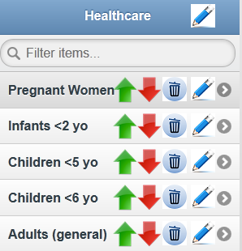
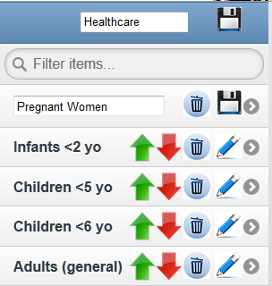
Edit Title
Click on Edit Icon
Make changes
Click on Save Icon

Slide 4
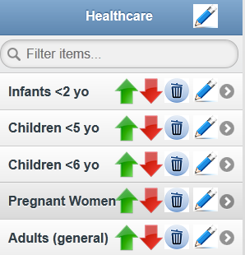
Change Order of Menu Items
Click on Up and Down arrows to change order of menu items

Slide 5
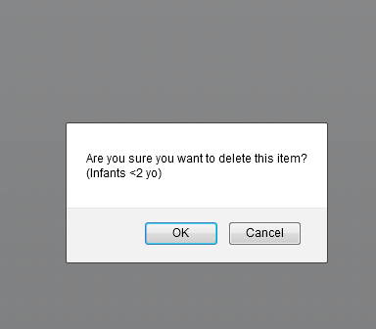
Delete Menu Item
Click on Trash Icon
Confirm Deletion

Slide 6
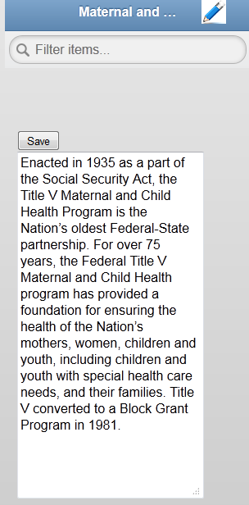
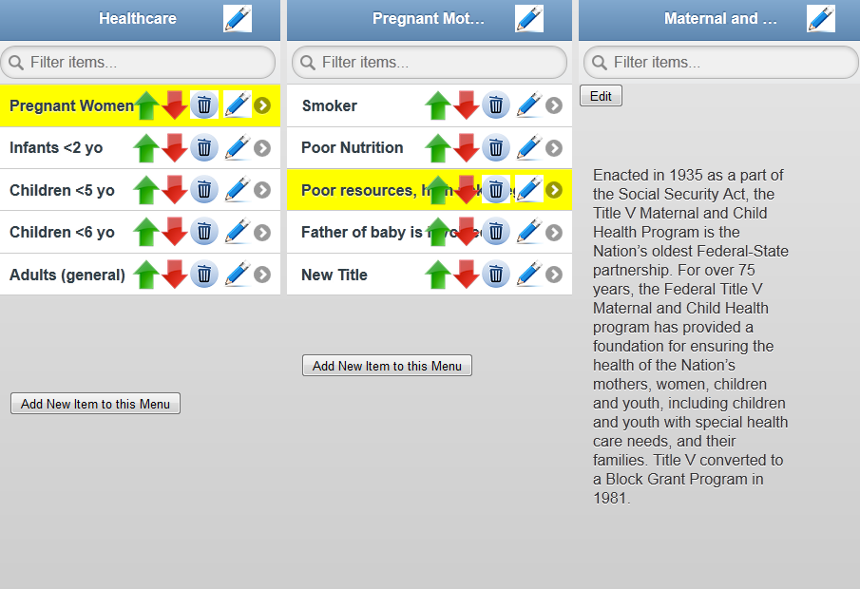
Edit Endpage Content
Navigate to end page
Click on Edit button
Make changes and click on save button

Slide 7
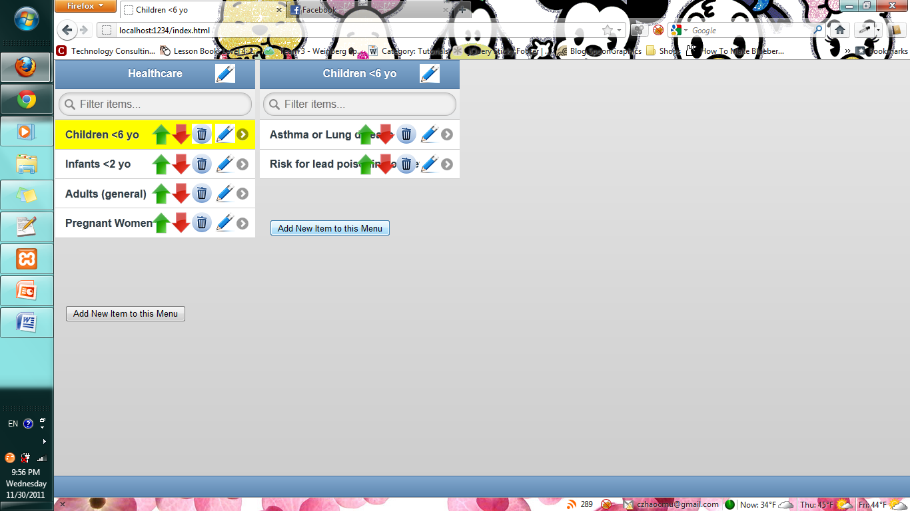
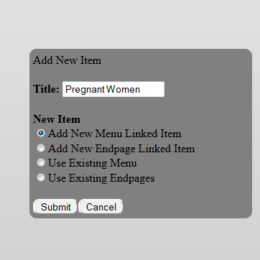
Add New Menu Linked Item
Type in Title
Make sure Add New Menu Linked Item is selected
Click Submit
Click on Add Item to this Menu on desired menu level
(Creates a blank menu to add menu items to)

Slide 8
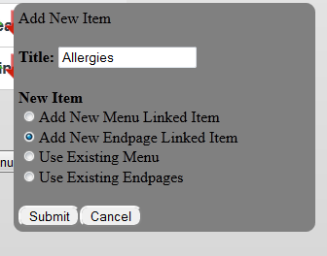
Add New Endpage Linked Item
Type in Title
Make sure Add New Endpage Linked Item is selected
Click Submit
Click on Add Item to this Menu on desired menu level
(Creates a menu item that links to a blank endpage)

Slide 9
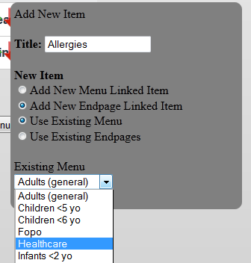
Use Existing Menu
Type in Title
Make sure Use Existing Menu is selected
Select a menu item from dropdown
Click Submit
Click on Add Item to this Menu on desired menu level

Slide 10
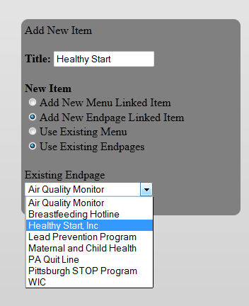
Use Existing Endpage
Type in Title
Make sure Use Existing Endpages is selected
Select an endpage from dropdown
Click Submit
Click on Add Item to this Menu on desired menu level

